Slide 1
Chapter 13 Abstract Classes and Interfaces

Slide 2
Abstract Class in Java
A class that is declared using “abstract” keyword is known as abstract class.
It can have abstract methods(methods without body)
As well as concrete methods (regular methods with body).
abstract class Animal{ public abstract void sound();
void anotherMethod(){ }
}

Slide 3
Abstract method in Java with examples
A method without body (no implementation) is known as abstract method.
A abstract method must always be declared in an abstract class, or in other words you can say that if a class has an abstract method, it should be declared abstract as well.

Slide 4
Remember
A normal class(non-abstract class) cannot have abstract methods.
An abstract class can not be instantiated, which means you are not allowed to create an object of it.
A class containing abstract method need to be abstract class.
An abstract class is like a template, so you have to extend it and build on it before you can use it.
If a class has an abstract method it should be declared abstract, the vice versa is not true, which means an abstract class doesn’t need to have an abstract method compulsory.

Slide 5
Public class Animal{
public void sound(){
System.out.println(“Animal");
}
}
public class Dog extends Animal
{ public void sound()
{ System.out.println("Woof");
}
public static void main(String args[])
{ Animal obj = new Dog();
obj.sound();
}
}
Output:
Woof

Slide 6
Why we need an abstract class?
Lets say we have a class Animal that has a method sound()
the subclasses of it like Dog, Lion, Horse, Cat etc.
Since the animal sound differs from one animal to another, there is no point to implement this method in parent class.
This is because every child class must override this method to give its own implementation details, like Lion class will say “Roar” in this method and Dog class will say “Bark”.
So then there is no point to implement this method in parent class.
Thus, making this method abstract would be the good choice as by making this method abstract we force all the sub classes to implement this method

Slide 7
Abstract class Example
abstract class Animal{
public abstract void sound();
}
public class Dog extends Animal
{ public void sound()
{ System.out.println("Woof");
}
public static void main(String args[])
{ Animal obj = new Dog();
obj.sound();
}
}
Output:
Woof

Slide 8
Rules
Note 1: When it is difficult or often unnecessary to implement all the methods in parent class. In these cases, we can declare the parent class as abstract
A class derived from the abstract class must implement all those methods that are declared as abstract in the parent class.
Note 2: Abstract class cannot be instantiated which means you cannot create the object of it. To use this class, you need to create another class that extends this this class and provides the implementation of abstract methods, then you can use the object of that child class to call non-abstract methods of parent class as well as implemented methods

Slide 9
Note 3: If a child does not implement all the abstract methods of abstract parent class, then the child class must need to be declared abstract as well.

Slide 10
Why can’t we create the object of an abstract class?
Because these classes are incomplete, they have abstract methods that have no body so if java allows you to create object of this class then if someone calls the abstract method using that object then What would happen?
There would be no actual implementation of the method to invoke.
Also because an object is concrete. An abstract class is like a template, so you have to extend it and build on it before you can use it.

Slide 11
abstract class AbstractDemo
{ public void myMethod()
{ System.out.println("Hello");
}
abstract public void anotherMethod();
}
public class Demo extends AbstractDemo
{ public void anotherMethod()
{ System.out.print("Abstract method");
}
public static void main(String args[])
{ //error: You can't create object of it
  AbstractDemo obj = new AbstractDemo(); obj.anotherMethod();
}
}
Output:
Unresolved compilation problem: Cannot instantiate the type AbstractDemo

Slide 12
we discussed abstract class which is used for achieving partial abstraction.
Abstraction is a process where you show only “relevant” data and “hide” unnecessary details of a class
Unlike abstract class an interface is used for full abstraction.

Slide 13
Interfaces
What is an interface?
Why is an interface useful?
How do you define an interface?
How do you use an interface?

Slide 14
What is an interface?
Interface looks like a class but it is not a class.
An interface can have methods and variables just like the class but the methods declared in interface are by default abstract (only method signature, no body).
the variables declared in an interface are public, static & final by default.

Slide 15
What is the use of interface in Java?
Used for full abstraction.
Since methods in interfaces do not have body, they have to be implemented by the class before you can access them.
The class that implements interface must implement all the methods of that interface.
Also, java programming language does not allow you to extend more than one class
However you can implement more than one interfaces in your class.

Slide 16
Define an Interface
To distinguish an interface from a class, Java uses the following syntax to define an interface:
public interface InterfaceName {
constant declarations;
abstract method signatures;
}
Example:
public interface Edible {
/** Describe how to eat */
public abstract String howToEat();
}

Slide 17
Interface is a Special Class
An interface is treated like a special class in Java. Each interface is compiled into a separate bytecode file, just like a regular class. Like an abstract class, you cannot create an instance from an interface using the new operator, but in most cases you can use an interface more or less the same way you use an abstract class. For example, you can use an interface as a data type for a variable, as the result of casting, and so on.

Slide 18
Example
interface MyInterface
{
public void method1();
public void method2();
}
class Demo implements MyInterface
{
public void method1()
{ System.out.println("implementation of method1");}
public void method2()
{ System.out.println("implementation of method2");}
public static void main(String arg[]) {
MyInterface obj = new Demo();
obj.method1();
} }
Output:
implementation of method1

Slide 19

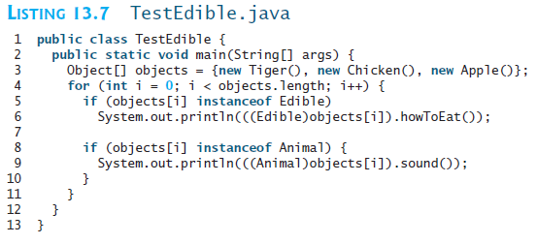
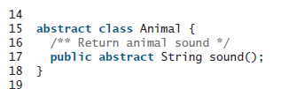

Slide 20

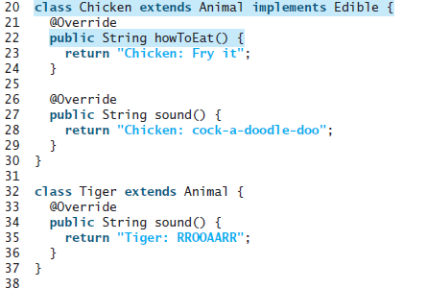

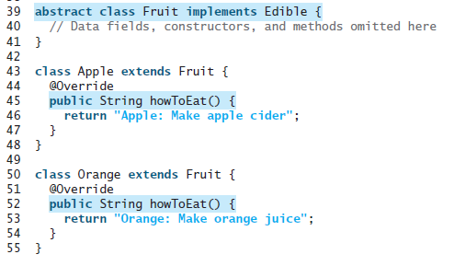

Slide 21
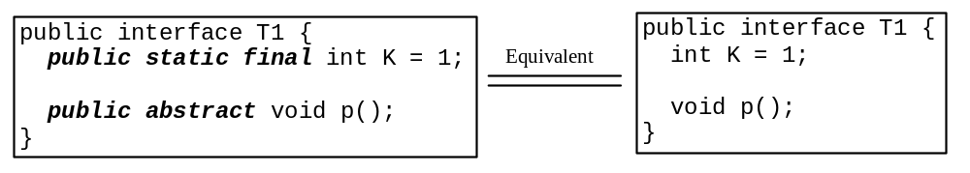
Omitting Modifiers in Interfaces
  All data fields are public final static and all methods are public abstract in an interface. For this reason, these modifiers can be omitted, as shown below:
  A constant defined in an interface can be accessed using syntax InterfaceName.CONSTANT_NAME (e.g., T1.K).

Slide 22
Example: The Comparable Interface
// This interface is defined in
// java.lang package
package java.lang;
public interface Comparable<E> {
public int compareTo(E o);
}

Slide 23
Java Comparable interface is used to order the objects of the user-defined class.
This interface is found in java.lang package and contains only one method named compareTo(Object).
It provides a single sorting sequence only, i.e., you can sort the elements on the basis of single data member only.
For example, it may be rollno, name, age or anything else.

Slide 24
compareTo(Object obj) method
public int compareTo(Object obj): It is used to compare the current object with the specified object. It returns
positive integer, if the current object is greater than the specified object.
negative integer, if the current object is less than the specified object.
zero, if the current object is equal to the specified object.
We can sort the elements of:
String objects
Wrapper class objects
User-defined class objects

Slide 25
class Student implements Comparable<Student>{
int rollno;
String name;
int age;
Student(int rollno,String name,int age){
this.rollno=rollno;
this.name=name;
this.age=age;
}
public int compareTo(Student st){
if(age==st.age)
return 0;
else if(age>st.age)
return 1;
else
return -1;
}
}

Slide 26
import java.util.*;
public class TestSort1{
public static void main(String args[]){
ArrayList<Student> al=new ArrayList<Student>();
al.add(new Student(101,"Vijay",23));
al.add(new Student(106,"Ajay",27));
al.add(new Student(105,"Jai",21));
Collections.sort(al);
for(Student st:al){
System.out.println(st.rollno+" "+st.name+" "+st.age);
}
}
}

Slide 27
The toString, equals, and hashCode Methods
Each wrapper class overrides the toString, equals, and hashCode methods defined in the Object class. Since all the numeric wrapper classes and the Character class implement the Comparable interface, the compareTo method is implemented in these classes.

Slide 28
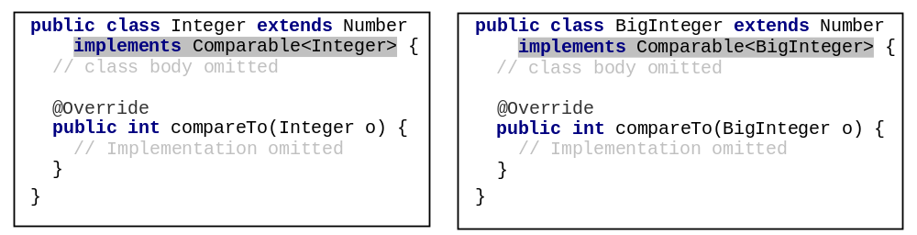
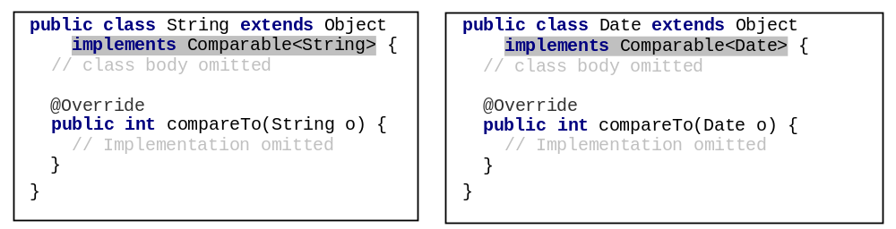
Integer and BigInteger Classes
String and Date Classes

Slide 29
Example
1 System.out.println(new Integer(3).compareTo(new Integer(5)));
2 System.out.println("ABC".compareTo("ABE"));
3 java.util.Date date1 = new java.util.Date(2013, 1, 1);
4 java.util.Date date2 = new java.util.Date(2012, 1, 1);
5 System.out.println(date1.compareTo(date2));

Slide 30
Generic sort Method
Let n be an Integer object, s be a String object, and d be a Date object. All the following expressions are true.
The java.util.Arrays.sort(array) method requires that the elements in an array are instances of Comparable<E>.
SortComparableObjects
Run

Slide 31
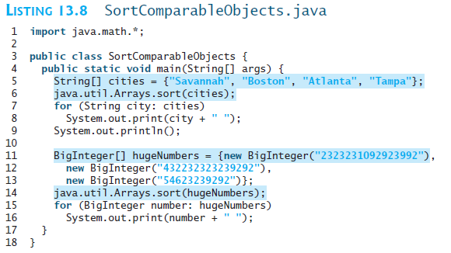


Slide 32
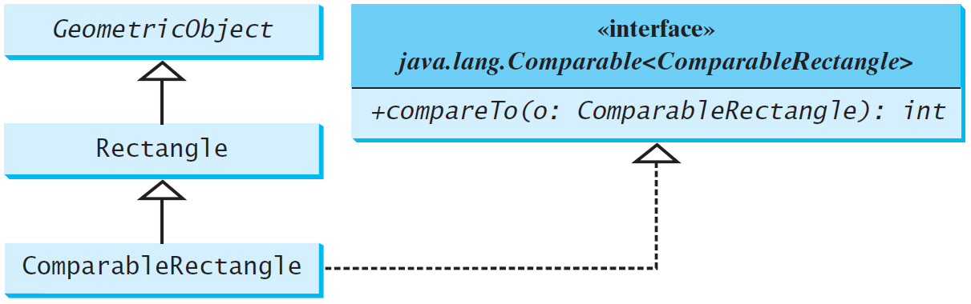
Defining Classes to Implement Comparable
ComparableRectangle
SortRectangles
Run

Slide 33
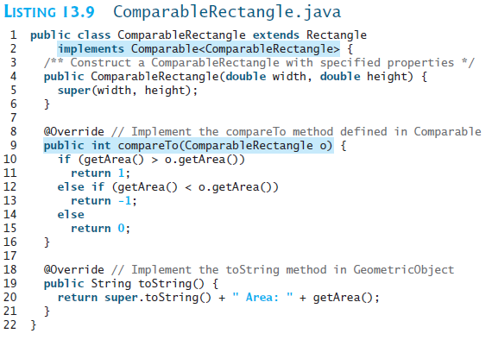

Slide 34
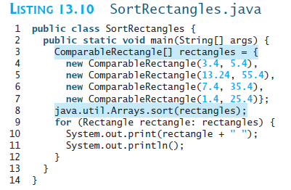


Slide 35
The Cloneable Interfaces
  As the name suggests, object cloning is a process of generating the exact copy of object with the different name.
  package java.lang;
  public interface Cloneable {
  }

Slide 36
Examples
public class DogName implements Cloneable
{ private String dname;
public DogName(String dname)
{ this.dname = dname; }
public String getName() { return dname; }
public Object clone()throws CloneNotSupportedException{ return (DogName)super.clone(); }
public static void main(String[] args) {
DogName obj1 = new DogName("Tommy");
try {
DogName obj2 = (DogName) obj1.clone(); System.out.println(obj2.getName()); }
catch (CloneNotSupportedException e) { e.printStackTrace(); } } }
Output:

Slide 37
Implementing Cloneable Interface
To define a custom class that implements the Cloneable interface, the class must override the clone() method in the Object class. The following code defines a class named House that implements Cloneable and Comparable.
House

Slide 38
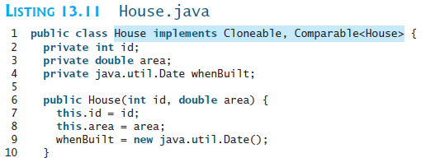
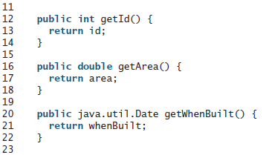

Slide 39
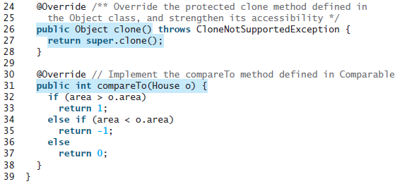

Slide 40
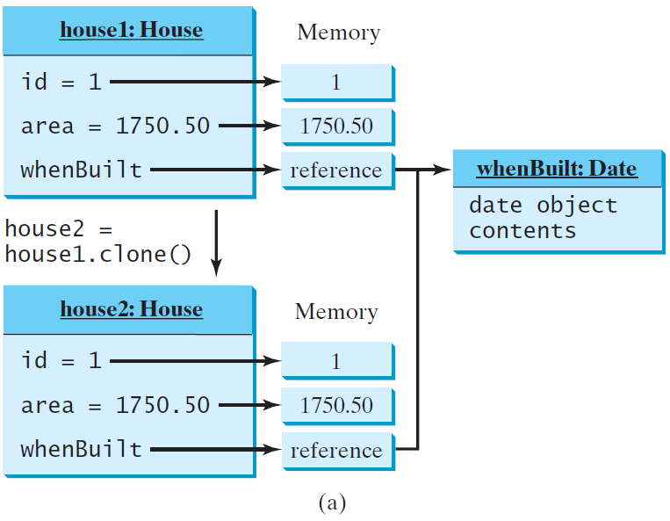
Shallow vs. Deep Copy
House house1 = new House(1, 1750.50);
House house2 = (House)house1.clone();
Shallow Copy

Slide 41
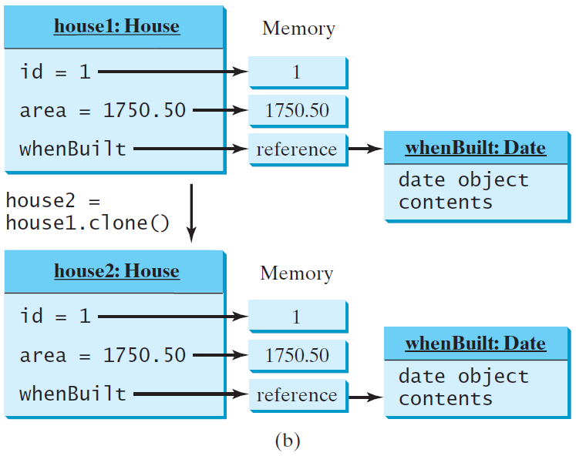
Shallow vs. Deep Copy
House house1 = new House(1, 1750.50);
House house2 = (House)house1.clone();
Deep Copy

Slide 42
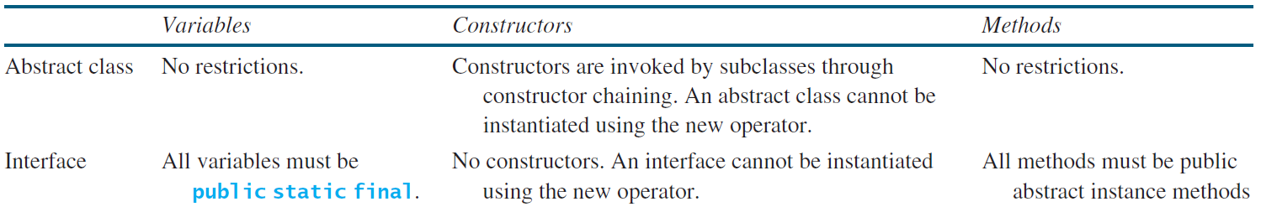
Interfaces vs. Abstract Classes
  In an interface, the data must be constants; an abstract class can have all types of data.
  Each method in an interface has only a signature without implementation; an abstract class can have concrete methods.

Slide 43
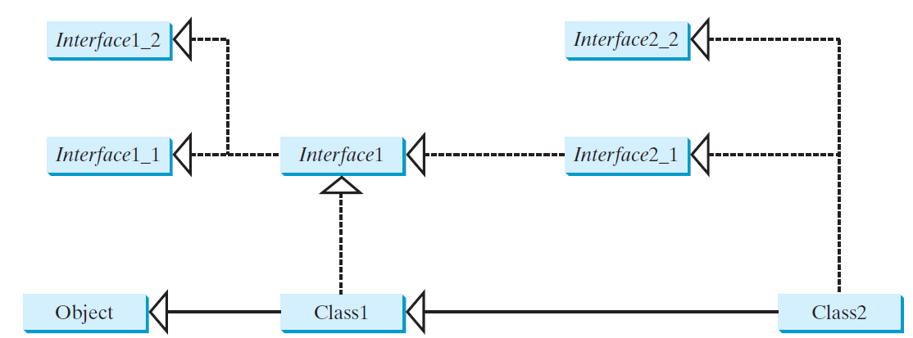
Interfaces vs. Abstract Classes, cont.
  All classes share a single root, the Object class, but there is no single root for interfaces. Like a class, an interface also defines a type. A variable of an interface type can reference any instance of the class that implements the interface. If a class extends an interface, this interface plays the same role as a superclass. You can use an interface as a data type and cast a variable of an interface type to its subclass, and vice versa.
  Suppose that c is an instance of Class2. c is also an instance of Object, Class1, Interface1, Interface1_1, Interface1_2, Interface2_1, and Interface2_2.

Slide 44
Caution: conflict interfaces
  In rare occasions, a class may implement two interfaces with conflict information (e.g., two same constants with different values or two methods with same signature but different return type). This type of errors will be detected by the compiler.

Slide 45
Whether to use an interface or a class?
  Abstract classes and interfaces can both be used to model common features. How do you decide whether to use an interface or a class? In general, a strong is-a relationship that clearly describes a parent-child relationship should be modeled using classes. For example, a staff member is a person. A weak is-a relationship, also known as an is-kind-of relationship, indicates that an object possesses a certain property. A weak is-a relationship can be modeled using interfaces. For example, all strings are comparable, so the String class implements the Comparable interface. You can also use interfaces to circumvent single inheritance restriction if multiple inheritance is desired. In the case of multiple inheritance, you have to design one as a superclass, and others as interface.

Slide 46
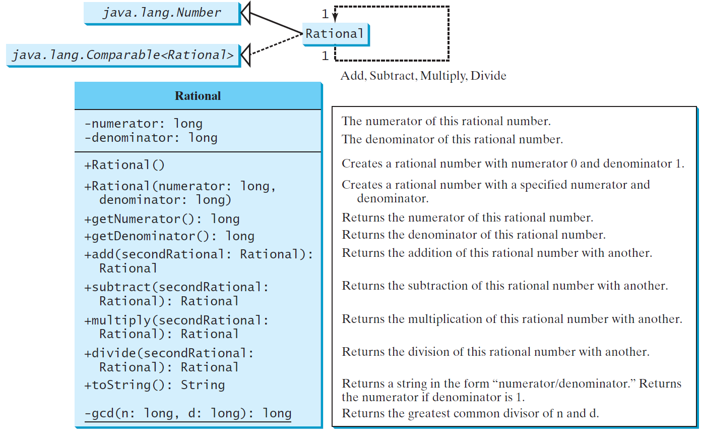
The Rational Class
Rational
TestRationalClass
Run

Slide 47
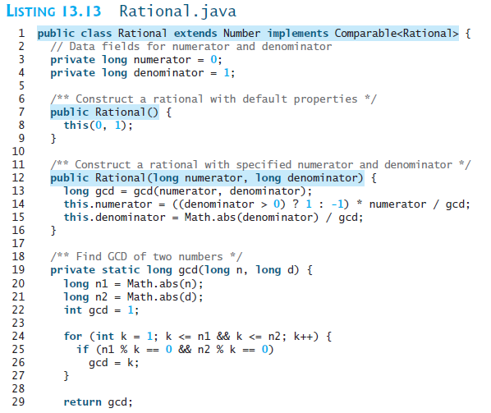

Slide 48

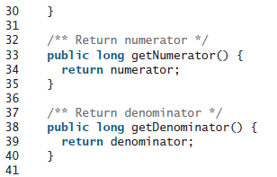
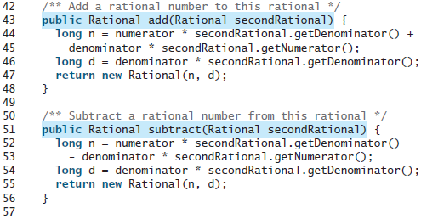

Slide 49
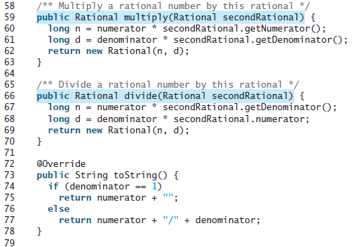
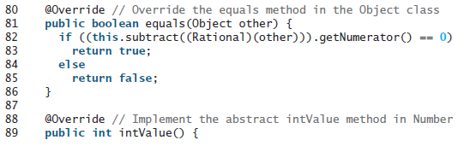

Slide 50
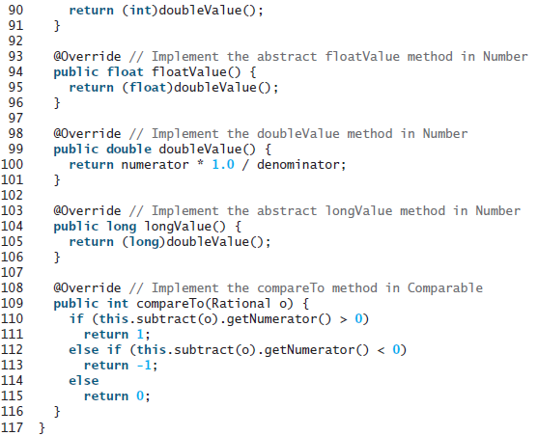

Slide 51
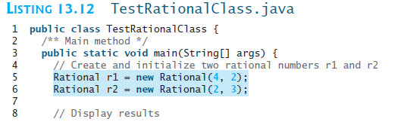
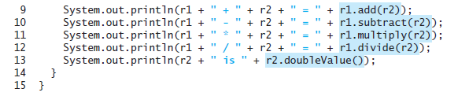
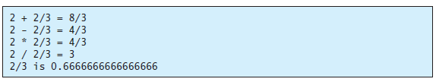

Slide 52
Designing a Class
(Coherence) A class should describe a single entity, and all the class operations should logically fit together to support a coherent purpose. You can use a class for students, for example, but you should not combine students and staff in the same class, because students and staff have different entities.

Slide 53
Designing a Class, cont.
(Separating responsibilities) A single entity with too many responsibilities can be broken into several classes to separate responsibilities. The classes String, StringBuilder, and StringBuffer all deal with strings, for example, but have different responsibilities. The String class deals with immutable strings, the StringBuilder class is for creating mutable strings, and the StringBuffer class is similar to StringBuilder except that StringBuffer contains synchronized methods for updating strings.

Slide 54
Designing a Class, cont.
Classes are designed for reuse. Users can incorporate classes in many different combinations, orders, and environments. Therefore, you should design a class that imposes no restrictions on what or when the user can do with it, design the properties to ensure that the user can set properties in any order, with any combination of values, and design methods to function independently of their order of occurrence.

Slide 55
Designing a Class, cont.
Provide a public no-arg constructor and override the equals method and the toString method defined in the Object class whenever possible.

Slide 56
Designing a Class, cont.
Follow standard Java programming style and naming conventions. Choose informative names for classes, data fields, and methods. Always place the data declaration before the constructor, and place constructors before methods. Always provide a constructor and initialize variables to avoid programming errors.

Slide 57
Using Visibility Modifiers
Each class can present two contracts – one for the users of the class and one for the extenders of the class. Make the fields private and accessor methods public if they are intended for the users of the class. Make the fields or method protected if they are intended for extenders of the class. The contract for the extenders encompasses the contract for the users. The extended class may increase the visibility of an instance method from protected to public, or change its implementation, but you should never change the implementation in a way that violates that contract.

Slide 58
Using Visibility Modifiers, cont.
A class should use the private modifier to hide its data from direct access by clients. You can use get methods and set methods to provide users with access to the private data, but only to private data you want the user to see or to modify. A class should also hide methods not intended for client use. The gcd method in the Rational class is private, for example, because it is only for internal use within the class.

Slide 59
Using the static Modifier
A property that is shared by all the instances of the class should be declared as a static property.

